Slide 1
Lesson 9: Forecasting

Slide 2
Today's Agenda
What is forecasting?
Autocorrelation, seasonality and noise
Auto regression
Moving average
Autoregressive Integrated Moving Average

Slide 3
Learning Objectives
Decompose time series into autocorrelation, seasonality, trend, and noise.
Explain the effects of exponential smoothing models and differentiate them from other models.
Apply and evaluate the results of an autoregressive model.
Apply and evaluate the results of a moving average model.
Apply and evaluate the results of an autoregressive integrated moving average model.
Apply and evaluate the results of ARIMA model for forecasting (time series prediction).

Slide 4
Prediction is very difficult, especially about the future.
- Niels Bohr

Slide 5
Types of Forecasting Methods
Decide what needs to be forecast
Level of detail, units of analysis & time horizon required
Evaluate and analyze appropriate data
Identify needed data & whether it’s available
Select and test the forecasting model
Cost, ease of use & accuracy
Generate the forecast
Monitor forecast accuracy over time

Slide 6
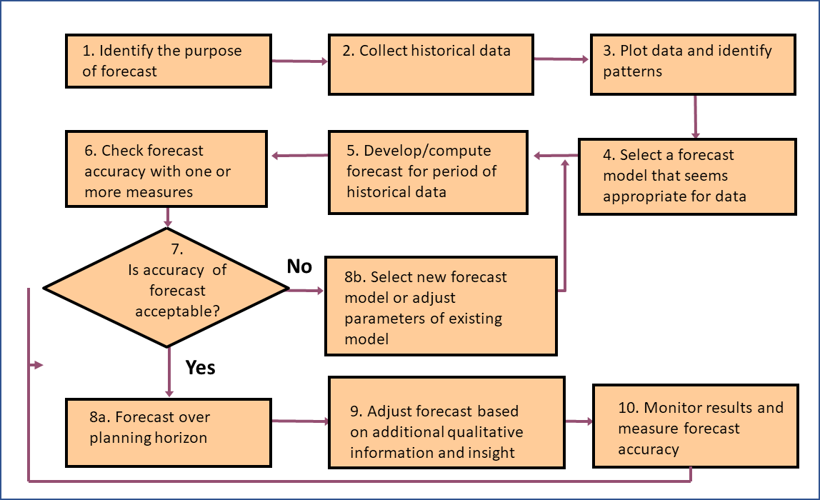
Forecasting In Practice

Slide 7
Time Series Data
Series of data observed over time
E.g.: Daily Amazon stock prices, Annual population data, Quarterly sales figures, …
Forecasting is estimating how the sequence of observations will continue into the future.

Slide 8
Time Series Data
Order matters
There is a dependency on time and changing the order could change the meaning of the data.

Slide 9
Quiz
A time series is a sequence of data points with the follow characteristics (choose all that apply):
1- Random intervals of time between each data point
2- Covers a continuous time interval
3- Equal spacing between every two consecutive measurements
4- Each time unit within the time interval has at most one data point.

Slide 10
Quiz
We would use time series forecasting to predict values for which following business situations (select all that apply):
1- Monthly Seattle bike rentals
2- A stock’s daily closing value
3- Amount of time to close a sales cycle
4- Retail trade area analysis and demographic profiling
5- Annual Orca population

Slide 11
Time Series Pattern
Trend:
Long-term movement in data
Seasonality:
Short-term regular variations in data
Cycles:
Wavelike variations of long-term
Irregular variations:
Caused by unusual circumstances
Random variations
Caused by chance

Slide 12
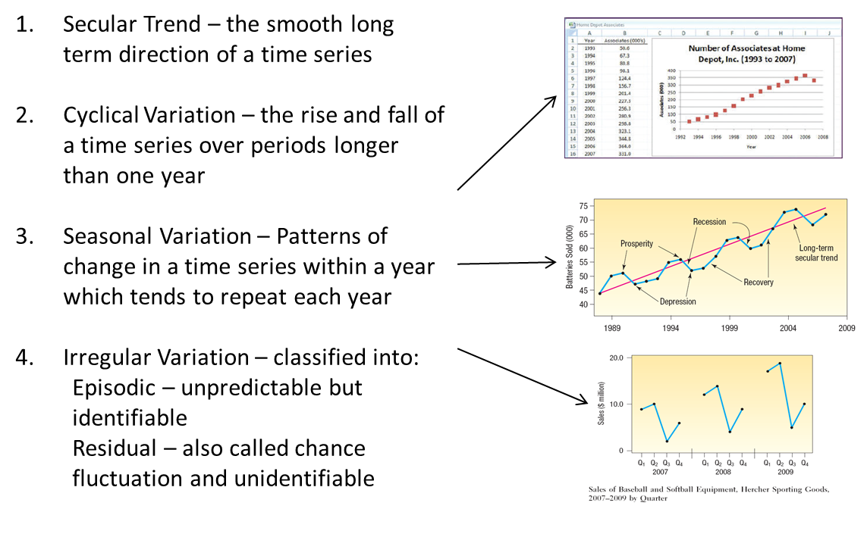
Time Series Components

Slide 13
Quiz
Mark each time series plots as seasonal, cyclical, both or neither.

Slide 14
Quiz
Seasonal - Peak electricity in summer and winter months repeats every year
Cyclical - shows pattern of downtrend every few years. The years are not fixed though.
Both - Seasonal patterns each year with cyclical pattern showing about every 9 years

Slide 15
Time Series Decomposition Plot
The first plot shows the actual time series.
The trend line indicates the general tendency of the time series
The seasonal portion shows that there’s a seasonal pattern
The residual is the error in the model that calculates the difference between the observed value and the trendline estimate

Slide 16
Simple Forecasting Methods
Average method: Forecast of all future values is equal to the mean of historical data
Naïve method: Forecasts equal to last observed value
Seasonal naïve method: Forecasts equal to last value from same season
Drift method: Forecasts equal to last value plus average change

Slide 17
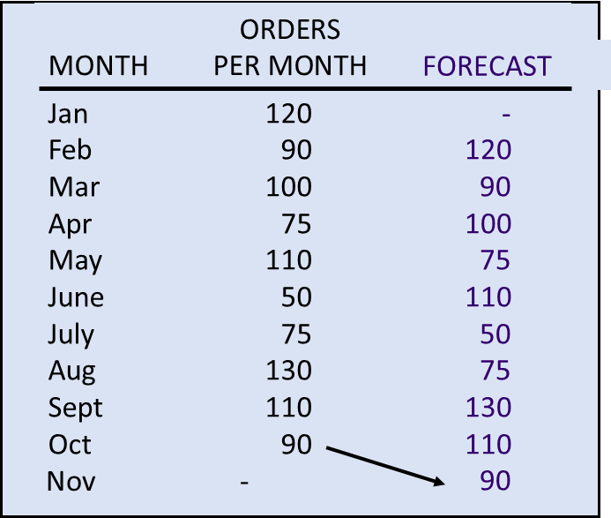
Moving Average: Naïve Approach

Slide 18
Moving Average
Simple moving average
uses average demand for a fixed sequence of periods
stable demand with no pronounced behavioral patterns
Weighted moving average
weights are assigned to most recent data

Slide 19
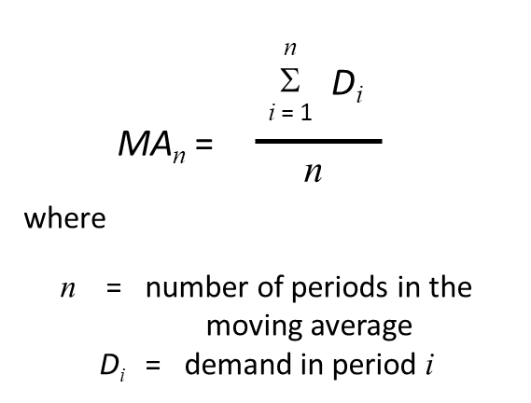
Simple Moving Average

Slide 20
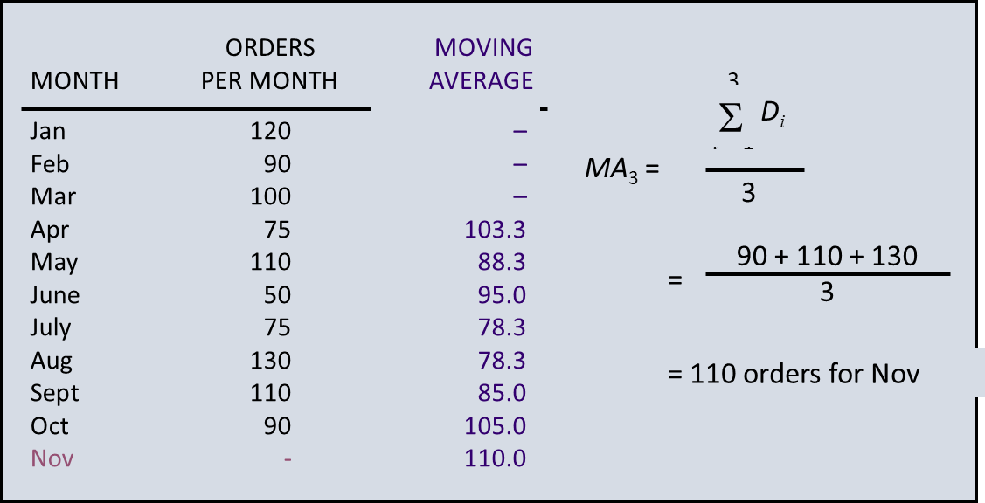
3-month Simple Moving Average

Slide 21
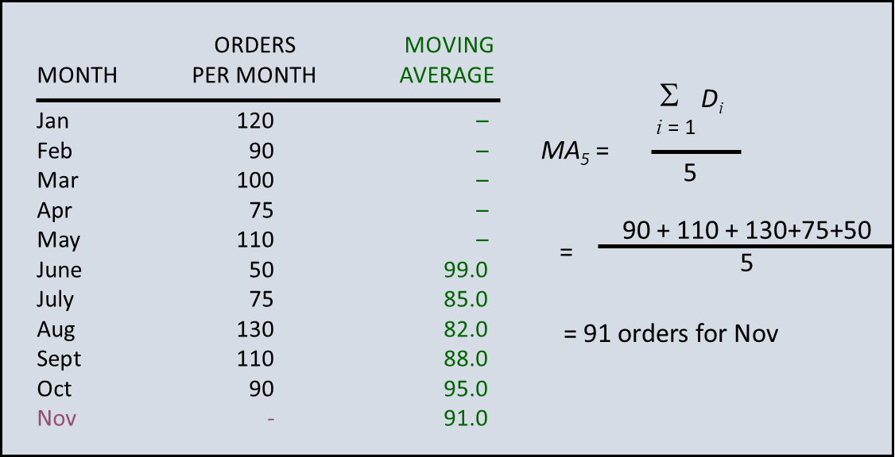
5-month Simple Moving Average

Slide 22
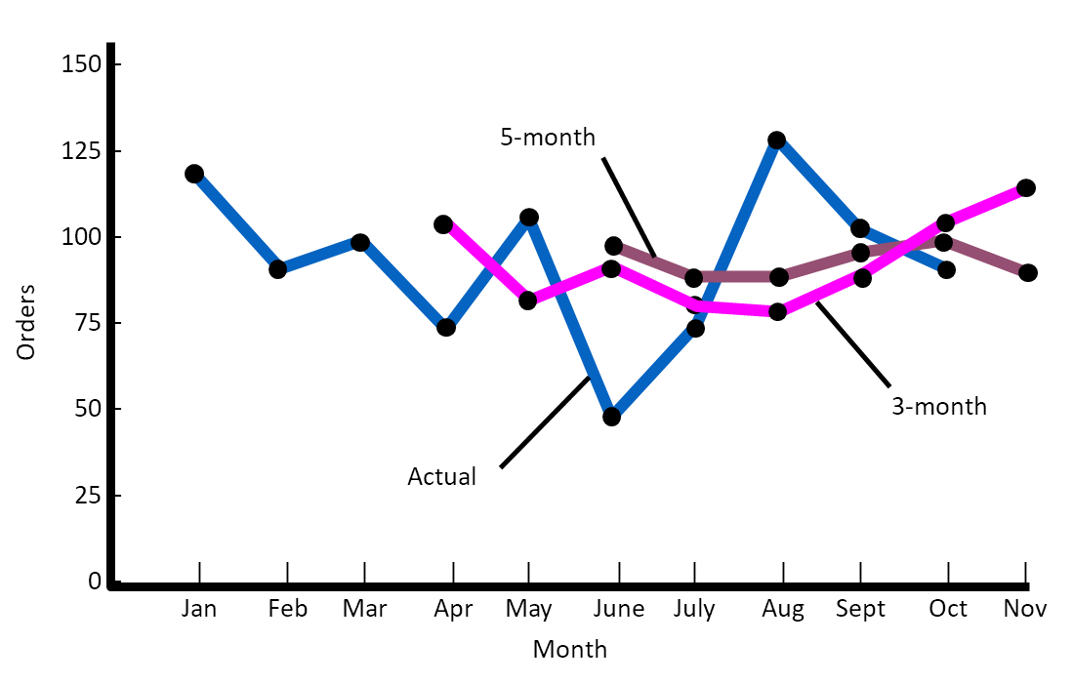
Smoothing Effects

Slide 23
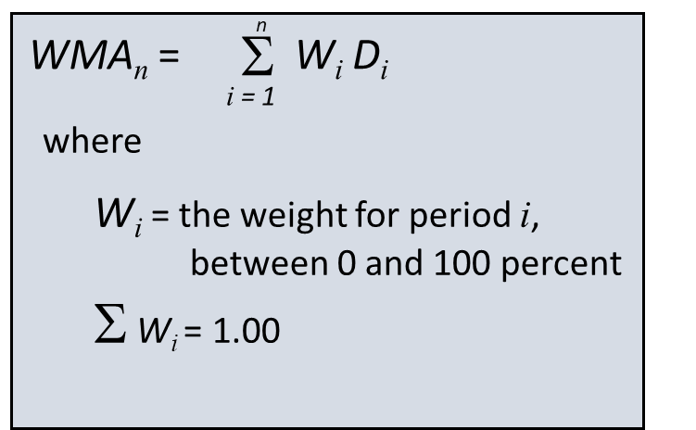
Weighted Moving Average
Adjusts moving average method to more closely reflect data fluctuations

Slide 24
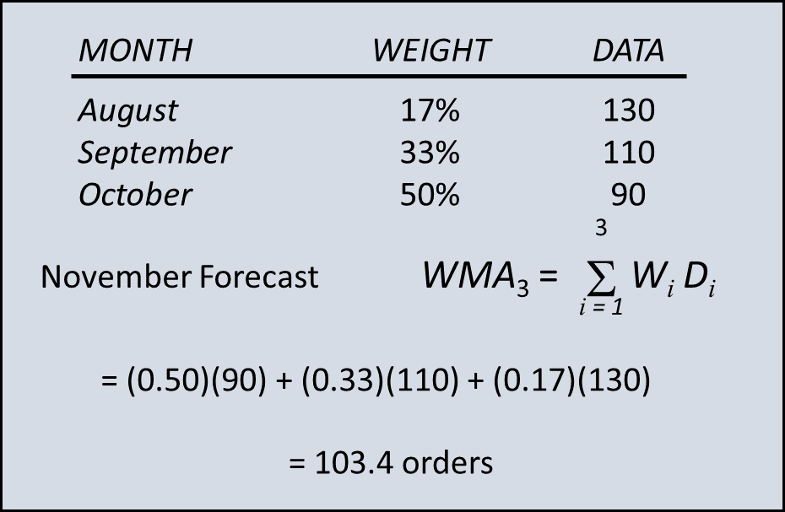
Weighted Moving Average Example

Slide 25
Exponential Smoothing
Averaging method
Weights most recent data more strongly
Reacts more to recent changes
Widely used, accurate method

Slide 26
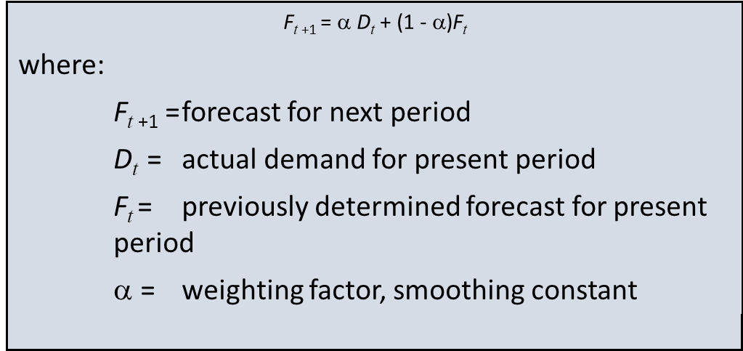
Exponential Smoothing

Slide 27
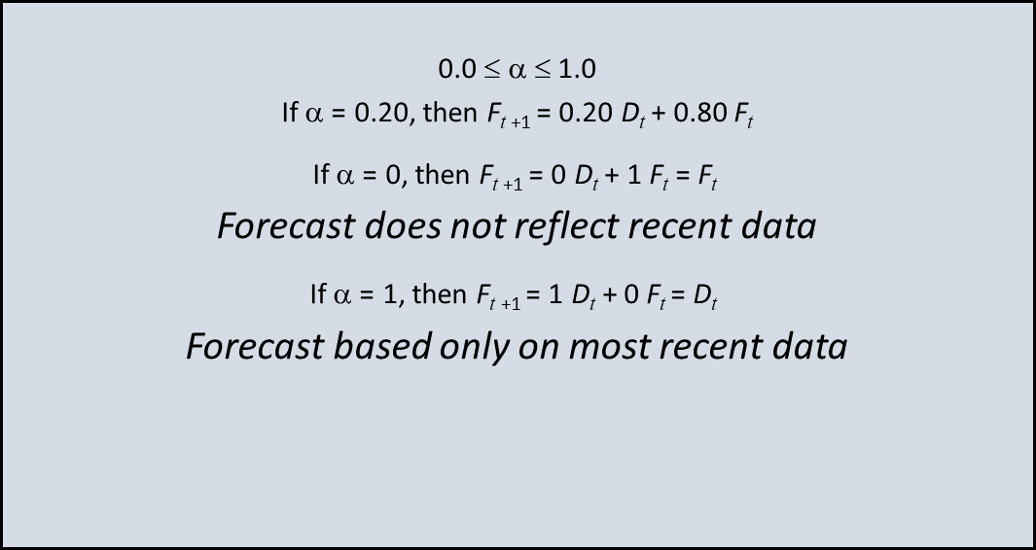
Effect of Smoothing Constant

Slide 28
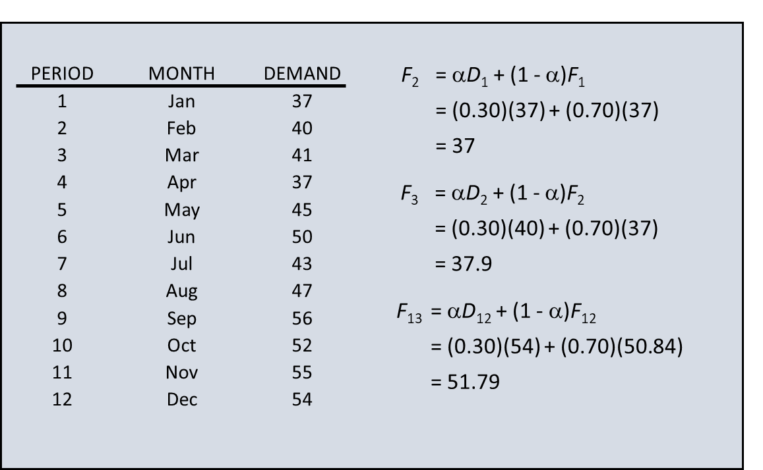
Exponential Smoothing (α=0.30)

Slide 29
Exponential Smoothing (α=0.30)

Slide 30
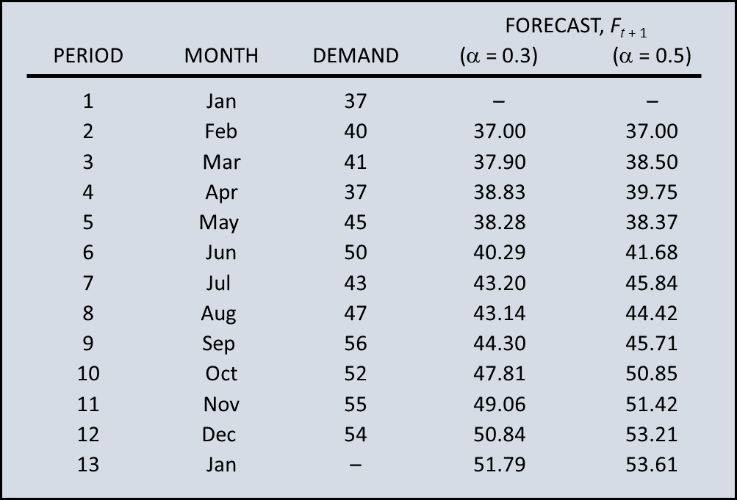
Exponential Smoothing

Slide 31
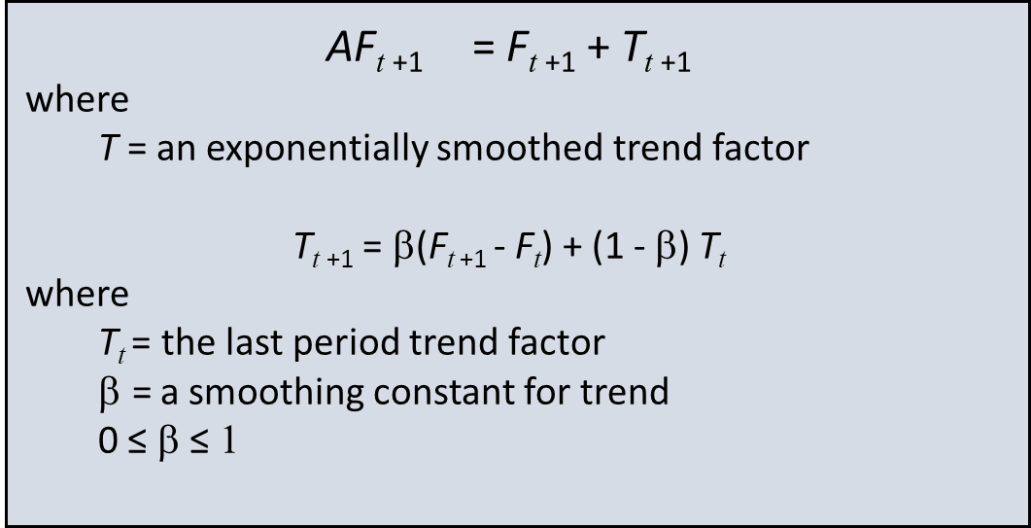
Adjusted Exponential Smoothing

Slide 32
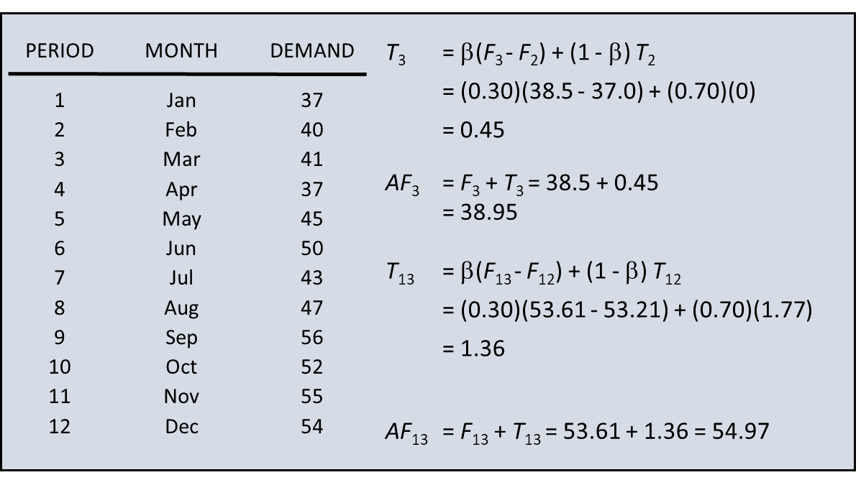
Adjusted Exponential Smoothing (β=0.30)

Slide 33
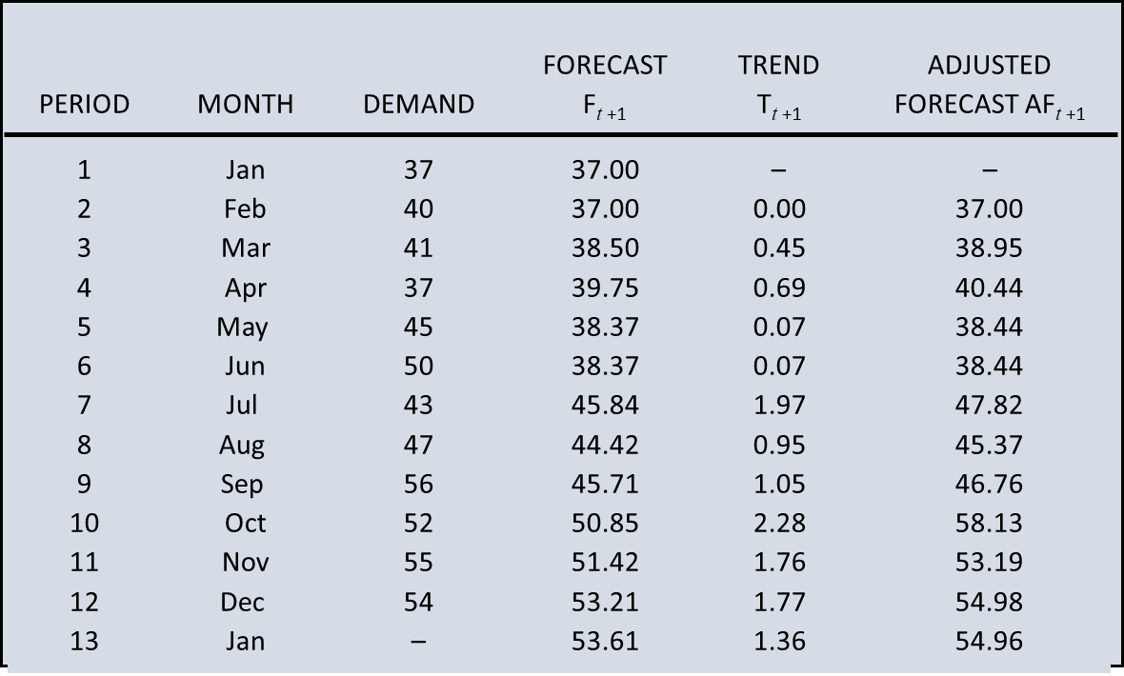
Adjusted Exponential Smoothing

Slide 34
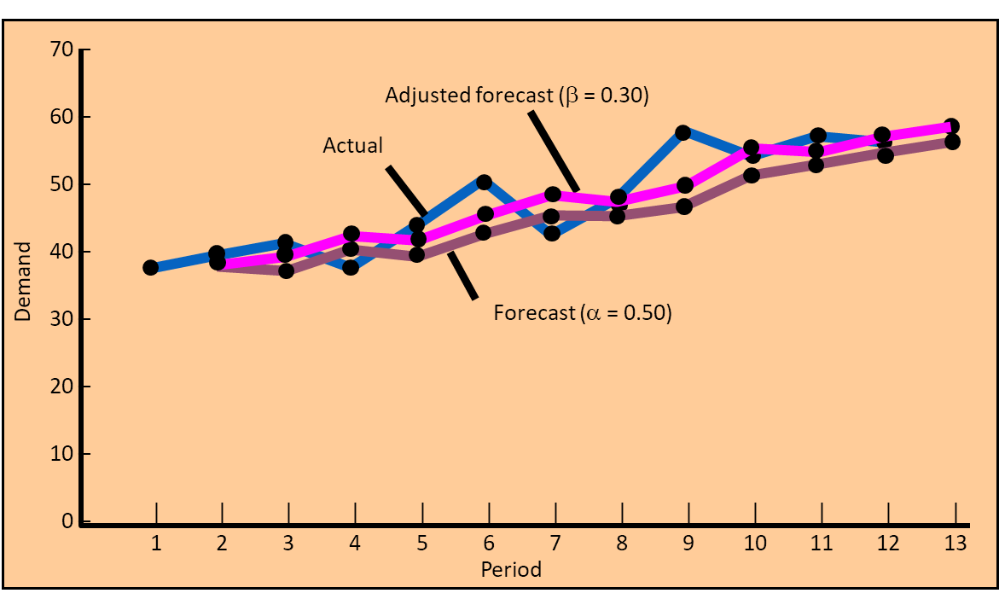
Adjusted Exponential Smoothing Forecasts

Slide 35
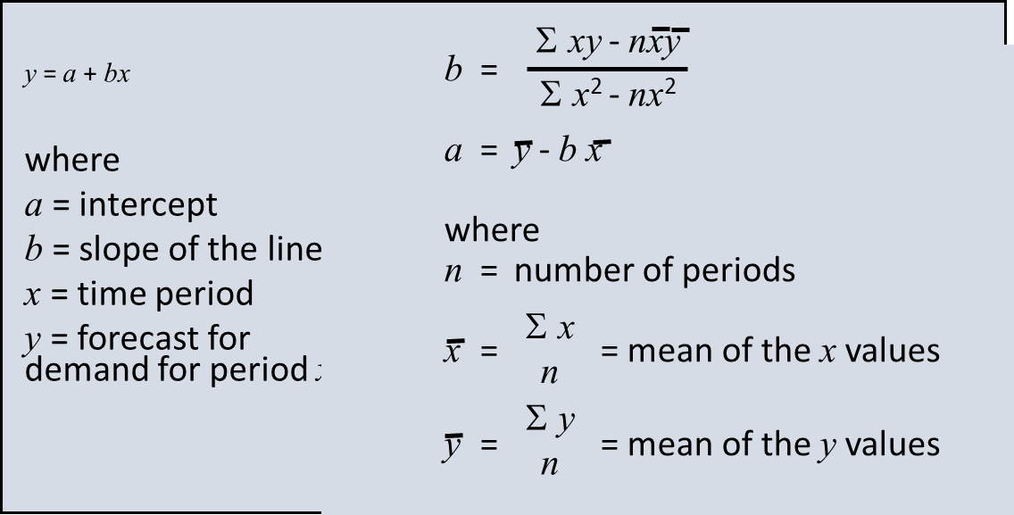
Linear Trend Line

Slide 36
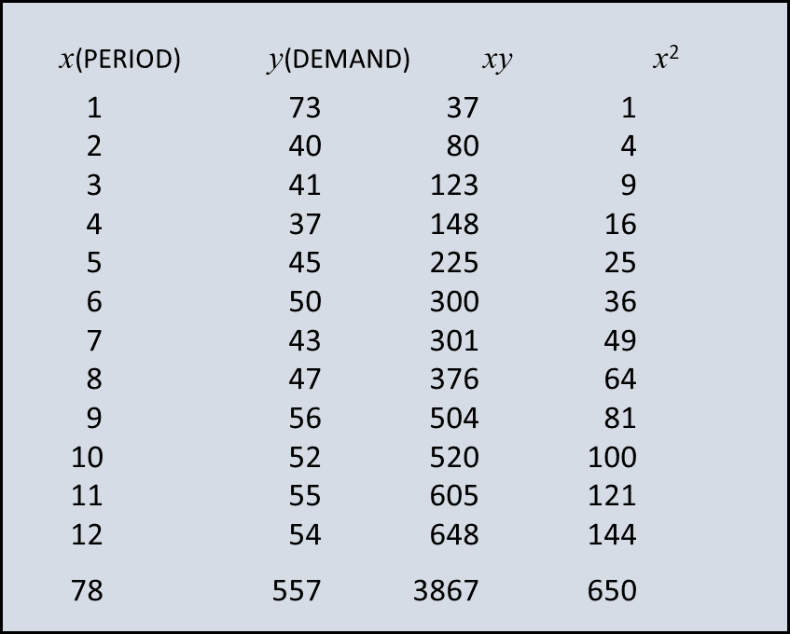
Least Squares Example

Slide 37
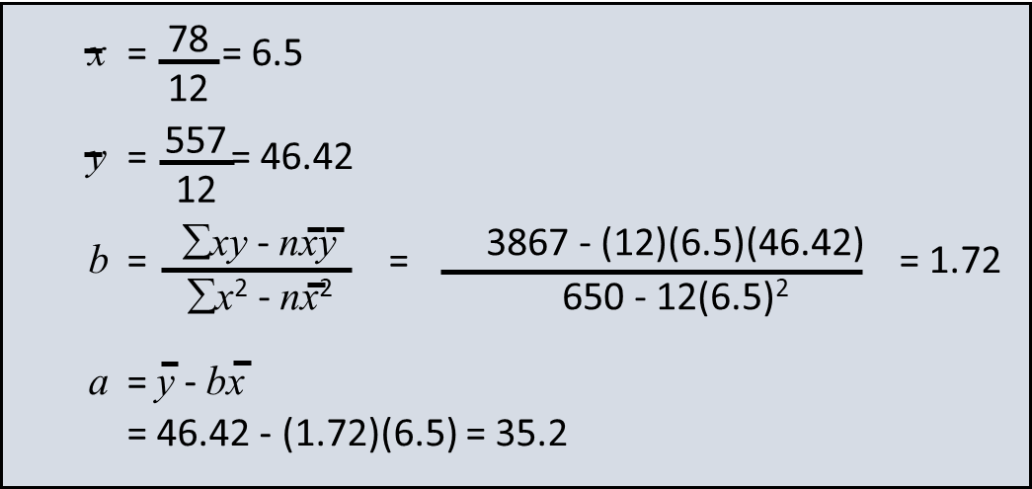
Least Squares Example

Slide 38
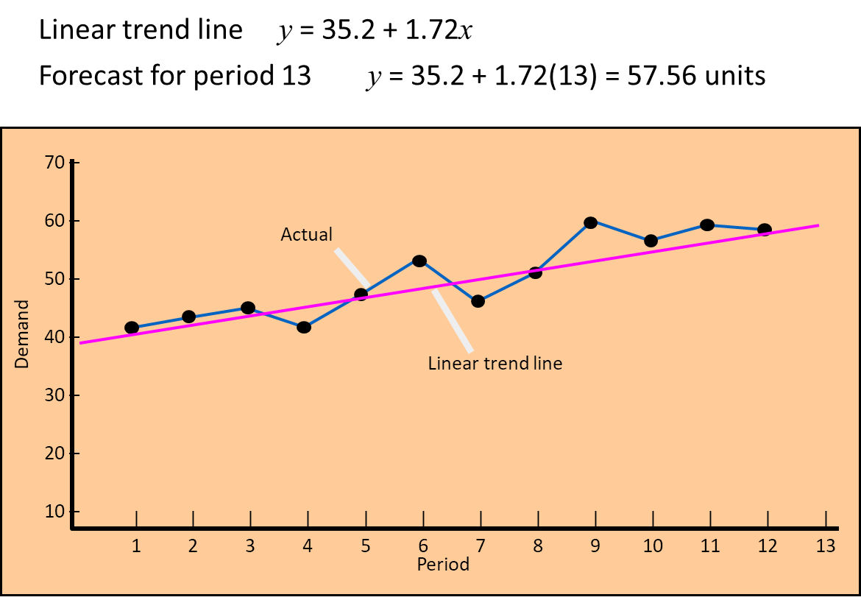
Adjusted Exponential Smoothing Forecasts

Slide 39
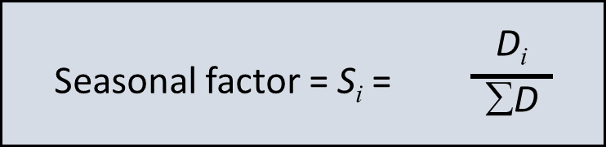
Seasonal Adjustments
Repetitive increase/ decrease in demand
Use seasonal factor to adjust forecast

Slide 40
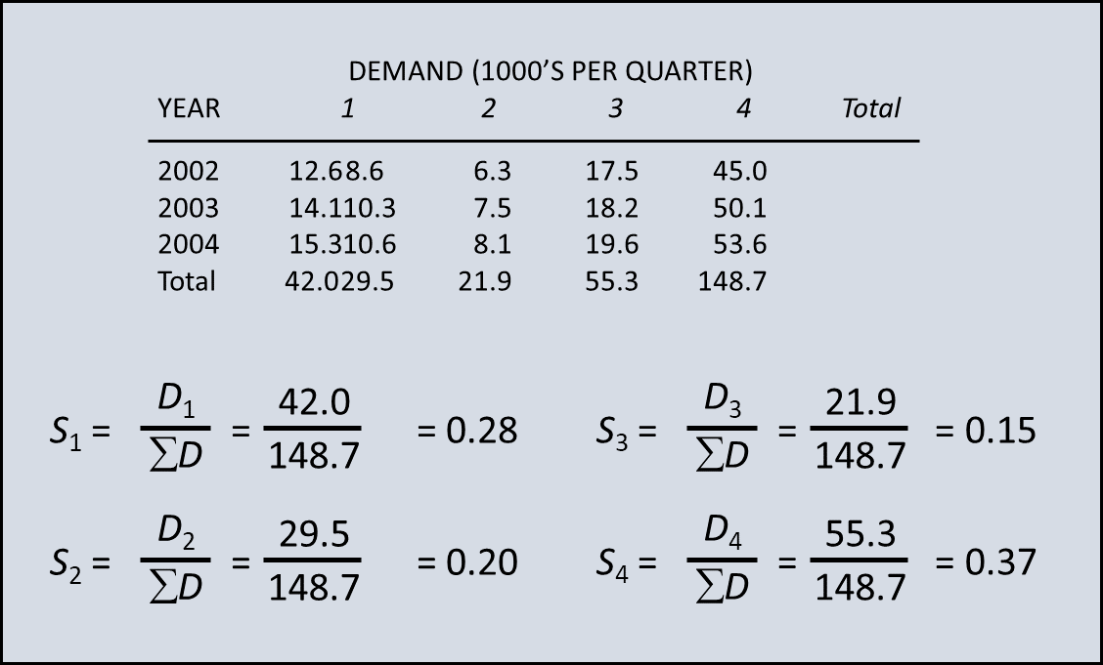
Seasonal Adjustment

Slide 41
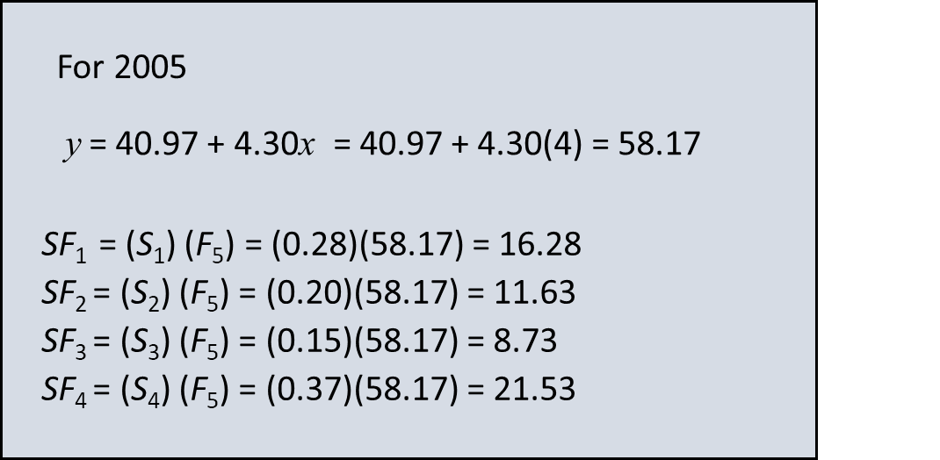
Seasonal Adjustment

Slide 42
Forecast Accuracy
Forecast error
difference between forecast and actual demand
MAD
mean absolute deviation
MAPD
mean absolute percent deviation
Cumulative error
Average error or bias

Slide 43
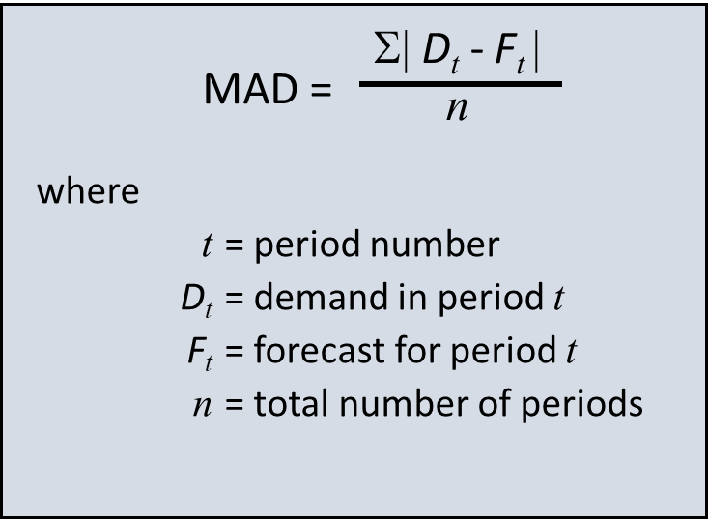
Mean Absolute Deviation (MAD)

Slide 44
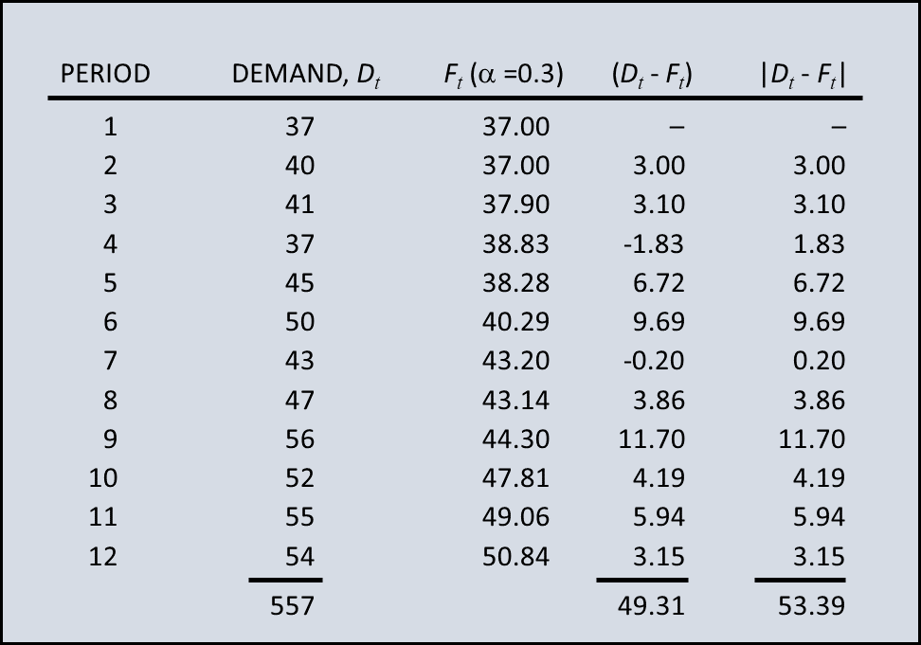
MAD Example

Slide 45
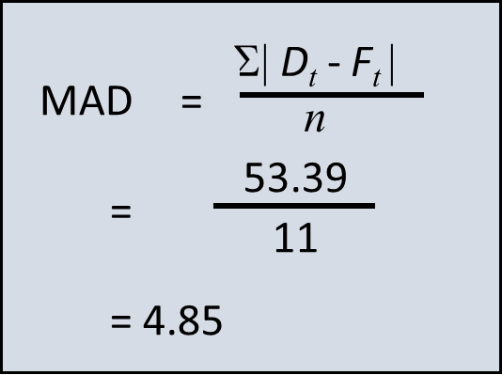
MAD Calculation

Slide 46
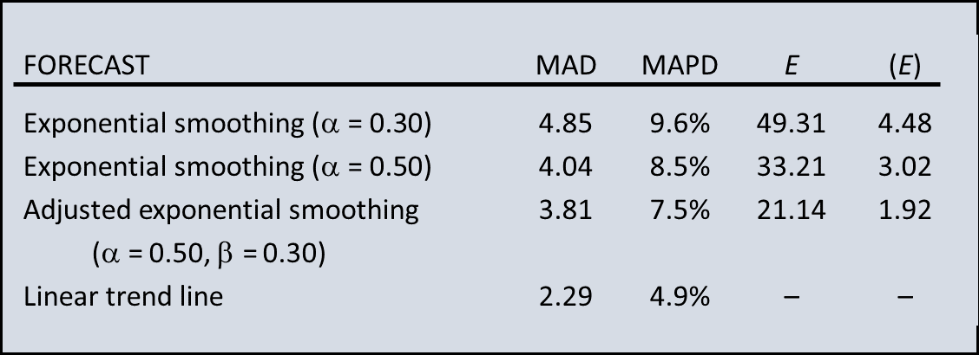
Comparison of Forecasts

Slide 47
Regression Methods
Linear regression
mathematical technique that relates a dependent variable to an independent variable in the form of a linear equation
Correlation
a measure of the strength of the relationship between independent and dependent variables

Slide 48
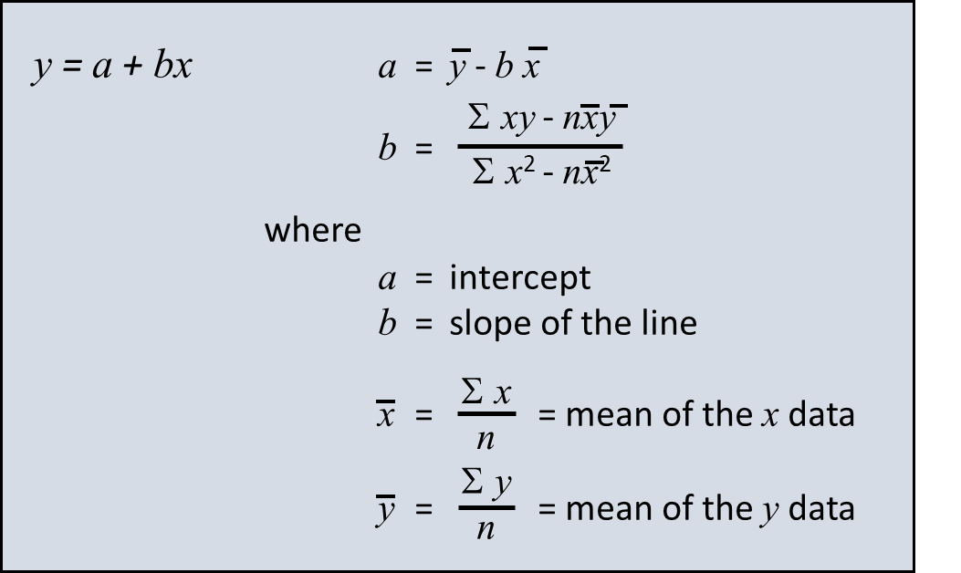
Linear Regression

Slide 49
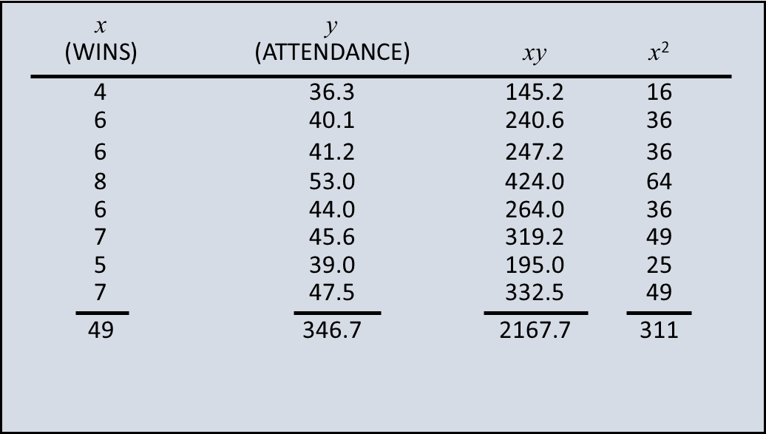
Linear Regression Example

Slide 50
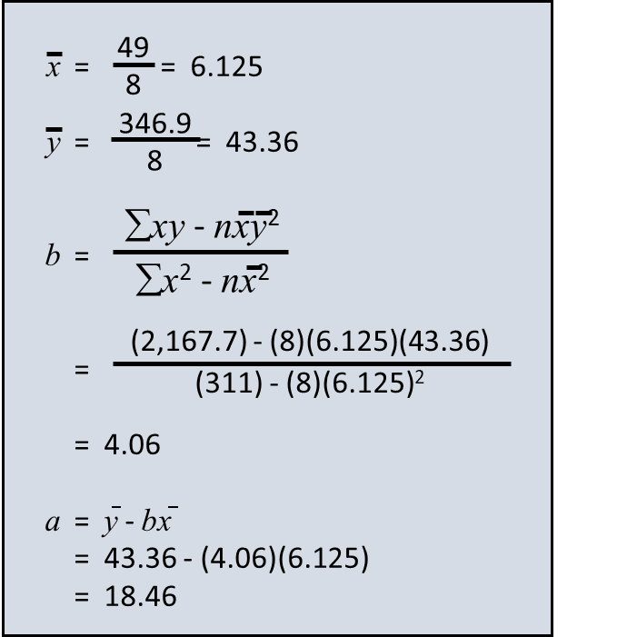
Linear Regression Example

Slide 51
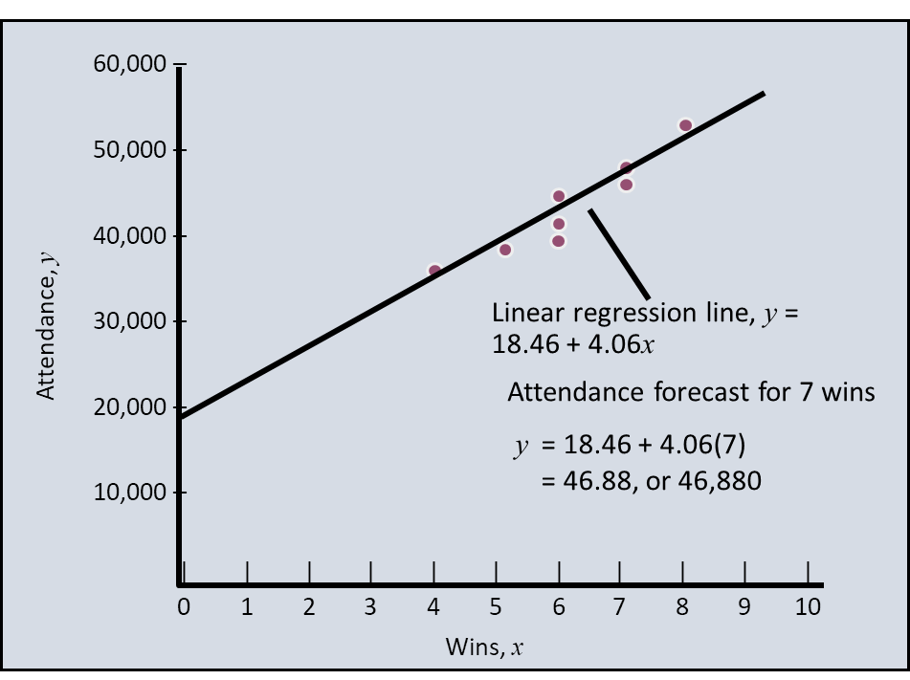
Linear Regression Example

Slide 52
Correlation and Coefficient of Determination
Correlation, r
Measure of strength of relationship
Varies between -1.00 and +1.00
Coefficient of determination, r²
Percentage of variation in dependent variable resulting from changes in the independent variable

Slide 53
ARIMA Models and Forecasting
If we can describe the way the points in the series are related to each other (the autocorrelations), then we can describe the series using the relationships that we’ve found
AutoRegressive Integrated Moving Average Models (ARIMA) are mathematical models of the autocorrelation in a time series
One way to describe time series

Slide 54
ARIMA METHOD OF FORECASTING
The Autoregressive (AR) Model
The following is an AR(p) model:
where u_{t} is a white noise error term.
The Moving Average (MA) Model
We can also model Y_{t} as an the MA(q) model, a weighted, or moving, average of the current and past white noise error terms:

Slide 55
ARIMA METHOD OF FORECASTING (CONT.)
The Autoregressive Moving Average (ARMA) Model
The ARMA (p,q) model is a combination of AR (autoregressive) and MA (moving average) terms.
The Autoregressive Integrated Moving Average (ARIMA) Model
The BJ methodology is based on the assumption that the underlying time series is stationary or can be made stationary by differencing it one or more times.
This is known as the ARIMA (p, d, q) model, where d denotes the number of times a time series has to be differenced to make it stationary.

Slide 56
Autocorrelation
The major statistical tool for ARIMA models is the sample autocorrelation coefficient
n
__
__
Σ
( Y_{t} – Y )
( Y_{t-k} – Y )
r_{k} =
t=k+1
n
Σ
__
( Y_{t} – Y )²
t=1

Slide 57
Autocorrelations
r₁ indicates how successive values of Y relate to each other,
r₂ indicates how Y values two periods apart relate to each other, and so on.

Slide 58
ACF
Together, the autocorrelations at lags 1, 2, 3, etc. make up the autocorrelation function or ACF and then we plot the autocorrelations by the lags
The ACF values reflect how strongly the series is related to its past values over time.

Slide 59
Autocorrelation Function Plot
Autocorrelation refers to how correlated a time series is with its past values.
When data have a trend, the autocorrelations for small lags tend to be large and positive.
When data are seasonal, the autocorrelations will be larger at the seasonal lags
When data are trended and seasonal, you see a combination of these effects

Slide 60
Quiz
Match the ACF to the time series

Slide 61
Quiz
Match the ACF to the time series
1-B, 2-A, 3-D, 4-C

Slide 62
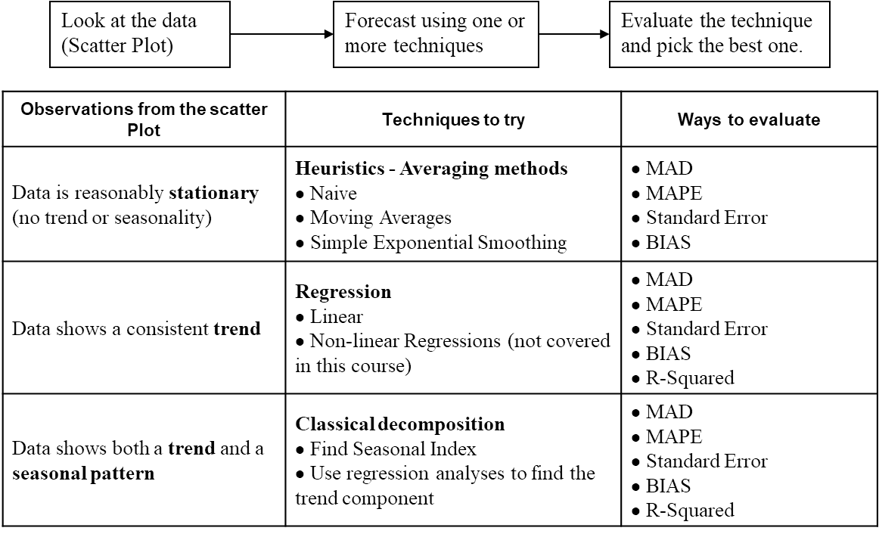
Time Series Forecasting Process

Slide 63
Evaluation of Forecasting Model
BIAS
The arithmetic mean of the errors
n is the number of forecast errors
Mean Absolute Deviation - MAD
Average of the absolute errors

Slide 64
Evaluation of Forecasting Model
Mean Square Error - MSE
Standard error
Square Root of MSE
Mean Absolute Percentage Error - MAPE
Calculate the % error using the absolute error, then average the results

Slide 65
Controlling the quality of forecast
Necessary to monitor forecast to ensure that the forecast is performing adequately
This is accomplished by comparing forecast errors to predetermined values
Errors that fall within the limits are considered acceptable
Errors outside either limit indicates that corrective action is needed
Tracking signal values are compared to predetermined limits (+4,-4) based on judgment and experience

Slide 66
Choosing a Forecasting Technique
Moving Averages and Exponential Smoothing are short range techniques. They produce forecast for the next period
Trend equations are used for much longer time horizons.
More than one forecasting techniques might be used to increase confidence
The forecast horizon
Forecasting frequency
Forecasting is not free
Consider cost and accuracy
Weigh cost-accuracy trade-offs carefully

